Slide 1


KEYLOGGERS
Bharath.S
Aalim Muhammed Salegh College of Engineering - CSE
Notes:
1

Slide 2

Problem Statement
1
Data Breaches
2
Privacy Violation
Keyloggers contribute to an increase in data breaches and unauthorized access to personal and confidential information.
They compromise privacy by capturing sensitive information such as passwords, credit card details, and personal messages.
3
Financial Loss
Individuals and organizations face the risk of financial loss due to fraudulent activities enabled by keyloggers.
Notes:
1

Slide 3

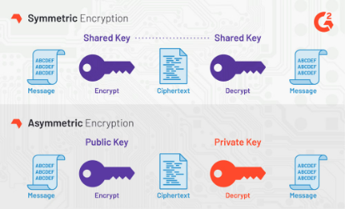
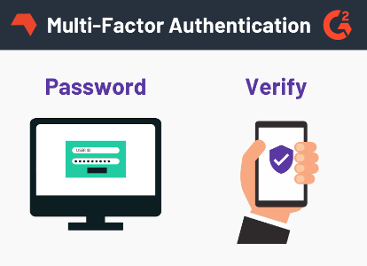
Proposed Solution
Behavior Monitoring
Advanced Encryption
Multi-factor Authentication
Implementing behavior-based monitoring systems can help detect and prevent keylogger activities.
Utilizing advanced encryption methods for sensitive data can safeguard against keylogger attacks.
Enforcing multi-factor authentication adds an extra layer of security, mitigating the impact of keyloggers.
Notes:
1

Slide 4
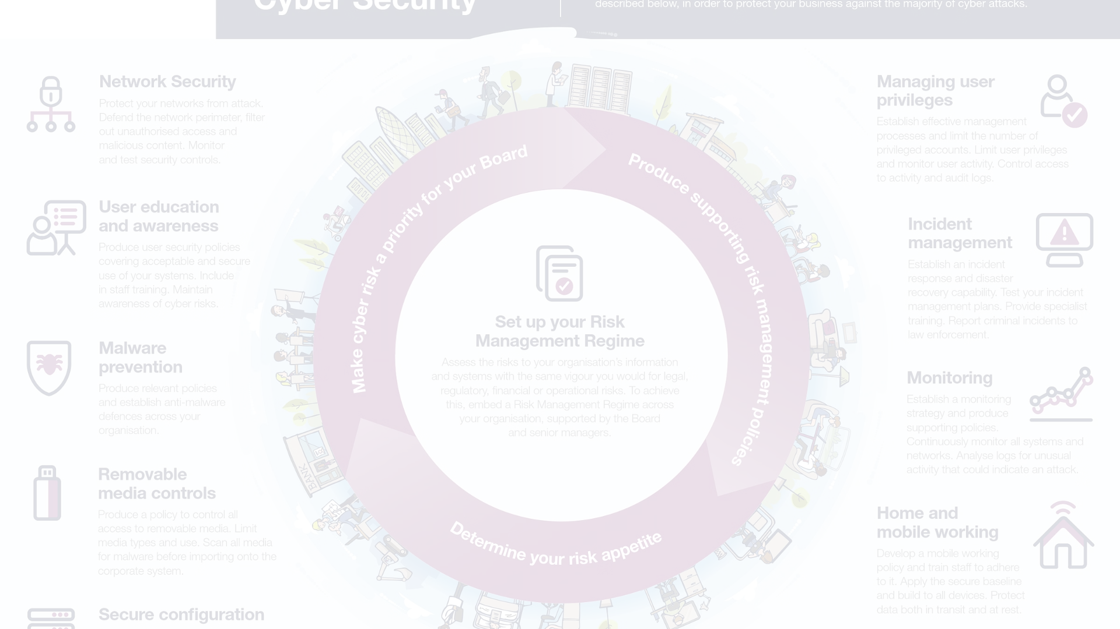



System Approach
Threat Analysis
Security Protocols
User Education
Conduct a comprehensive assessment to identify potential vulnerabilities targeted by keyloggers.
Implement robust security protocols, including firewalls and intrusion detection systems.
Education programs to increase awareness and promote safe digital practices among users.
Notes:
1

Slide 5
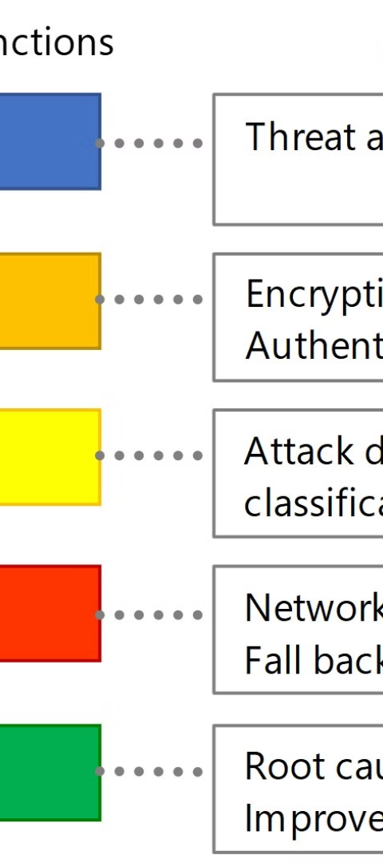
Algorithms and Deployment
1
Algorithm Development
Research and develop algorithms to detect and mitigate keylogger activities.
2
Testing and Validation
Thoroughly test the algorithms to ensure their effectiveness and reliability in real-world scenarios.
3
Deployment Strategy
Strategize the deployment process to seamlessly integrate security measures without disrupting operations.
Notes:
1

Slide 6
Result
Mitigated Risks
Enhanced Security
User Confidence
Reduced incidents of data breaches and unauthorized access.
Improved overall cybersecurity posture and resilience to attacks.
Increased trust and confidence in the security of digital systems.
Notes:
1

Slide 7

Output Image:
Notes:
1

Slide 8

Conclusion
Continuous Adaptation
Collaborative Efforts
Adapting to evolving cyber threats requires a sustained and proactive approach.
Collaboration between security experts, organizations, and individuals is essential for comprehensive defense strategies.
Educational Initiatives
Education and awareness programs form the foundation of a secure digital environment for all.
Notes:
1

Slide 9




Future Scope
Innovation
Technological Advancements
Ongoing Research
Global Collaboration
Pioneering innovative solutions to combat emerging cyber threats and vulnerabilities.
Exploring cutting-edge technologies to enhance cybersecurity frameworks and defenses.
Continuing research to stay ahead of new keylogger tactics and security challenges.
Fostering global collaboration to address keylogger threats on an international scale.
Notes:
<number>

